Slide 1
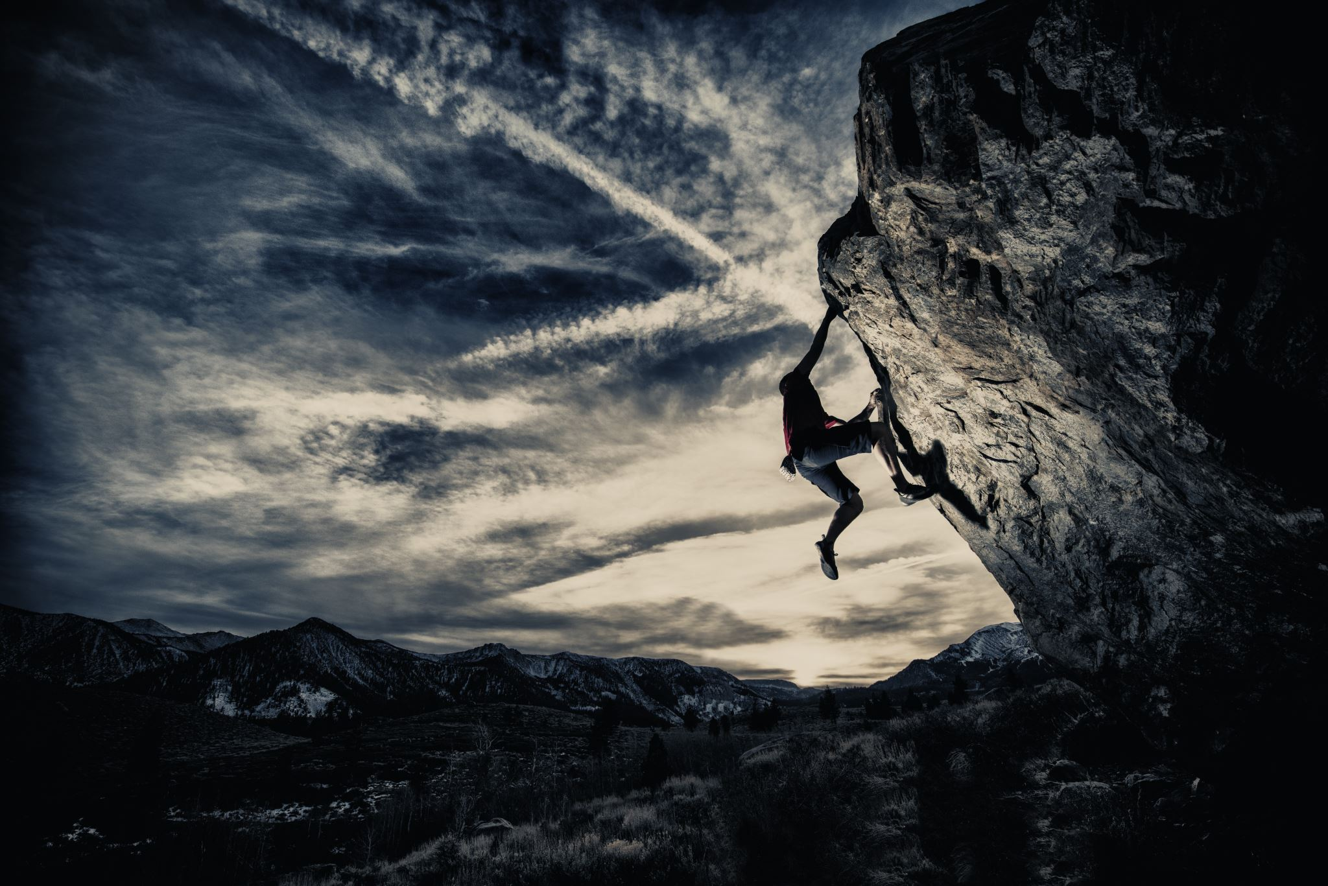
Climbing Club
Presented by Nick Cunha and Alex Wise
For the Spring 24' Semester

Slide 2

Membership
73 students in band, and interested in climbing
about half of the club are going once per week
About 30% are going twice per week or more
About 20% are going less than once per week
14 members are currently paying to go to Rock Club facility
$36 Fee

Slide 3
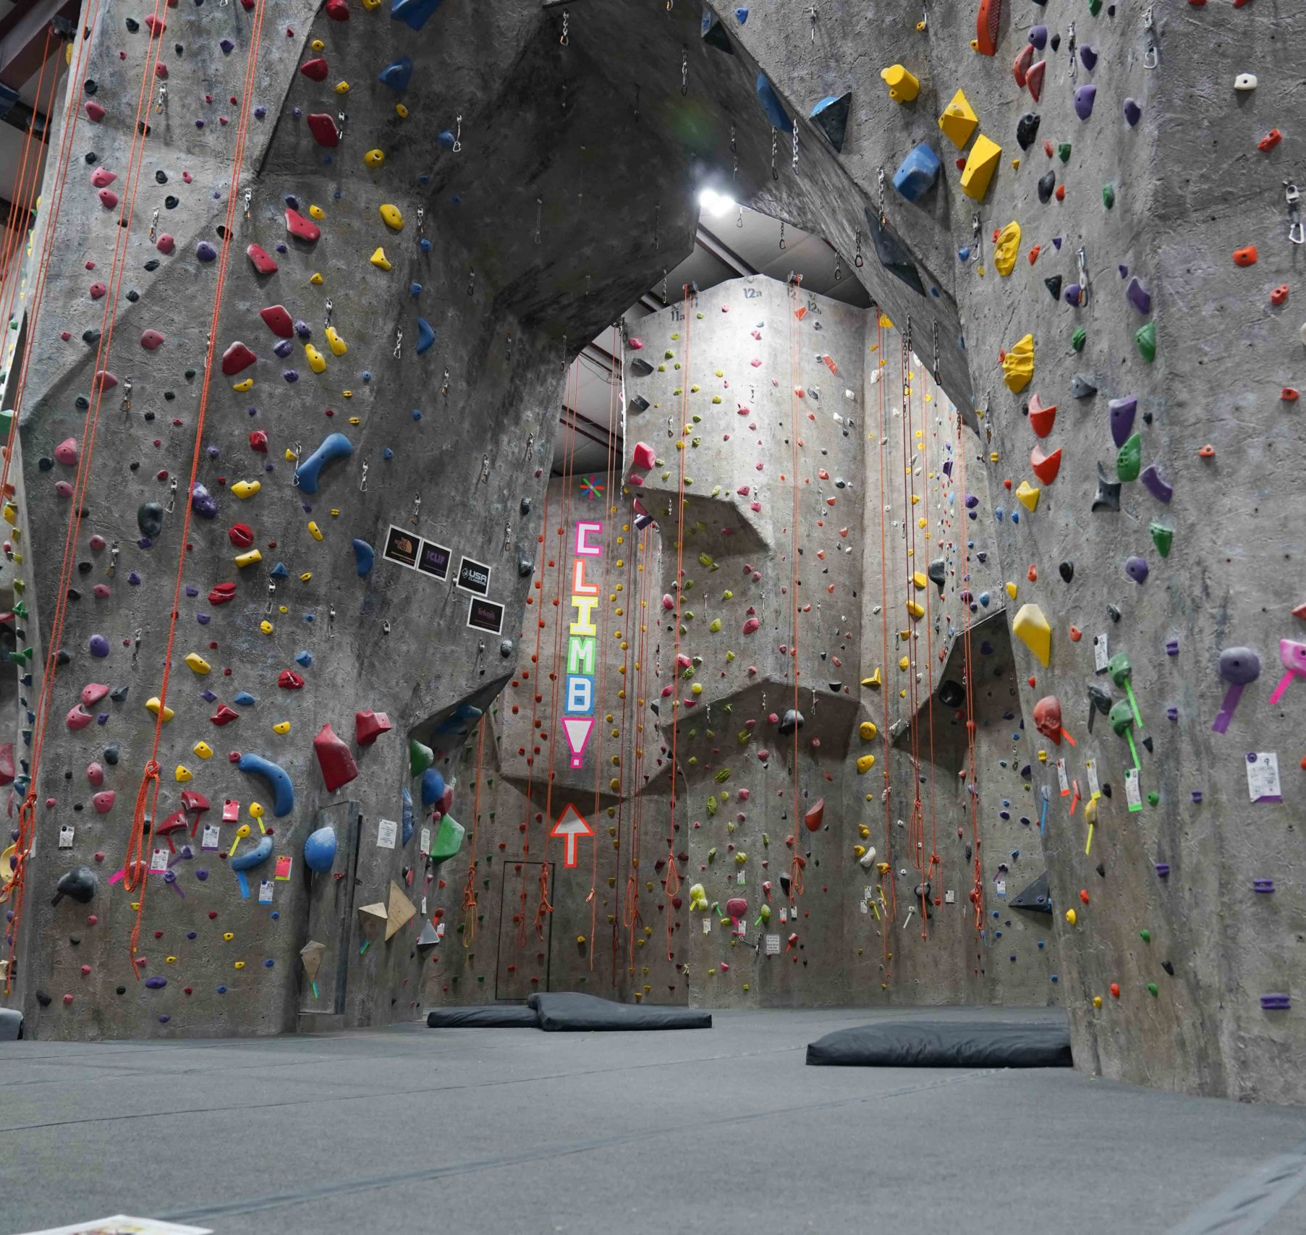
THE ROCK CLUB (Local Climbing Gym)
Facility In New Rochelle
Facility Open to all Club Members
Bouldering
Top Rope
Belaying
Lead Climbing
Slackline
Loft/Study area

Slide 4
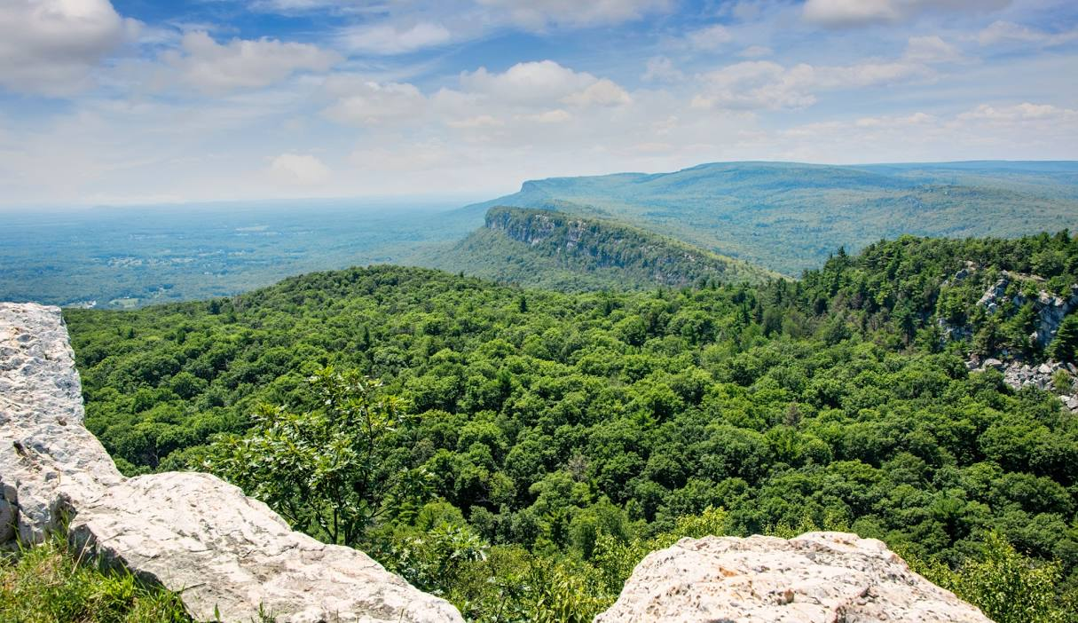
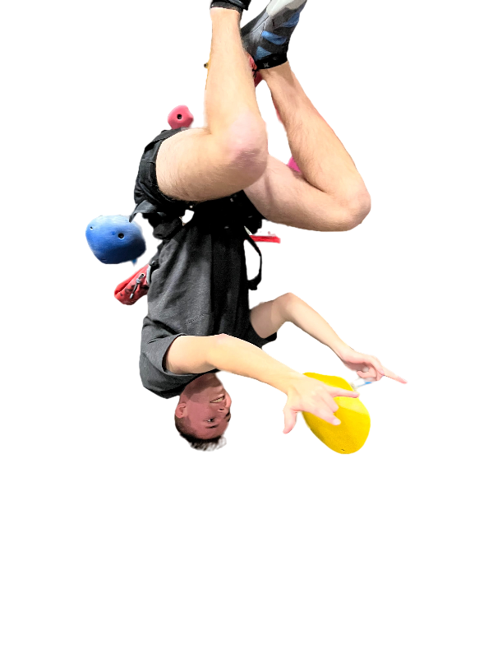
Shawangunk Ridge Mountains Trip (MUGS IN THE GUNKS)
Guided Climbing trip
$137 per person
Travel Costs
Hour car ride

Slide 5
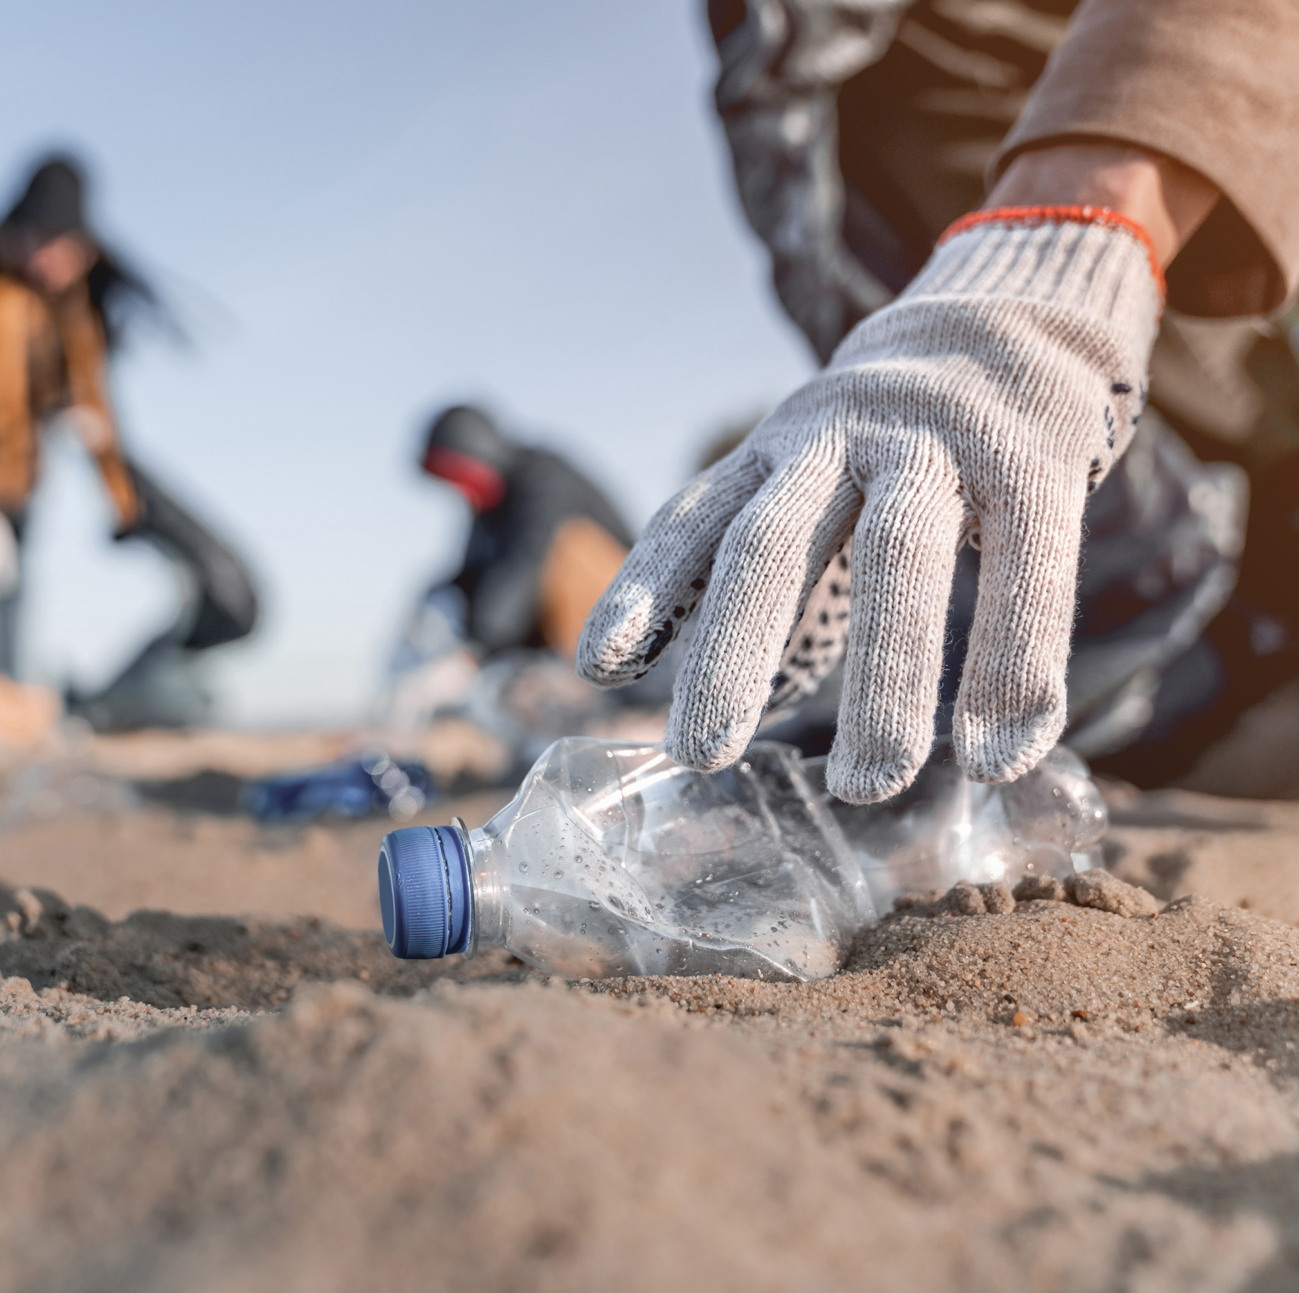
Community Service
Beach Cleanup planned for the Spring 2024 season
In Collaboration with environmental club
Done in previous semester

Slide 6
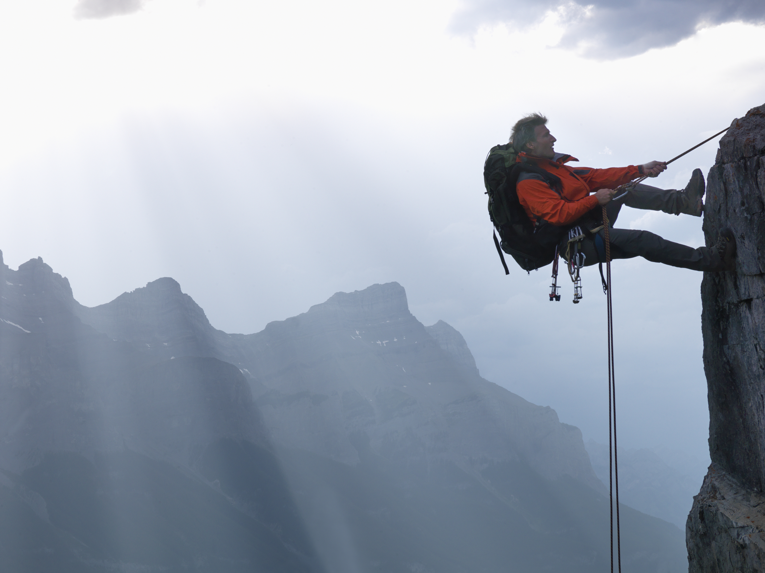
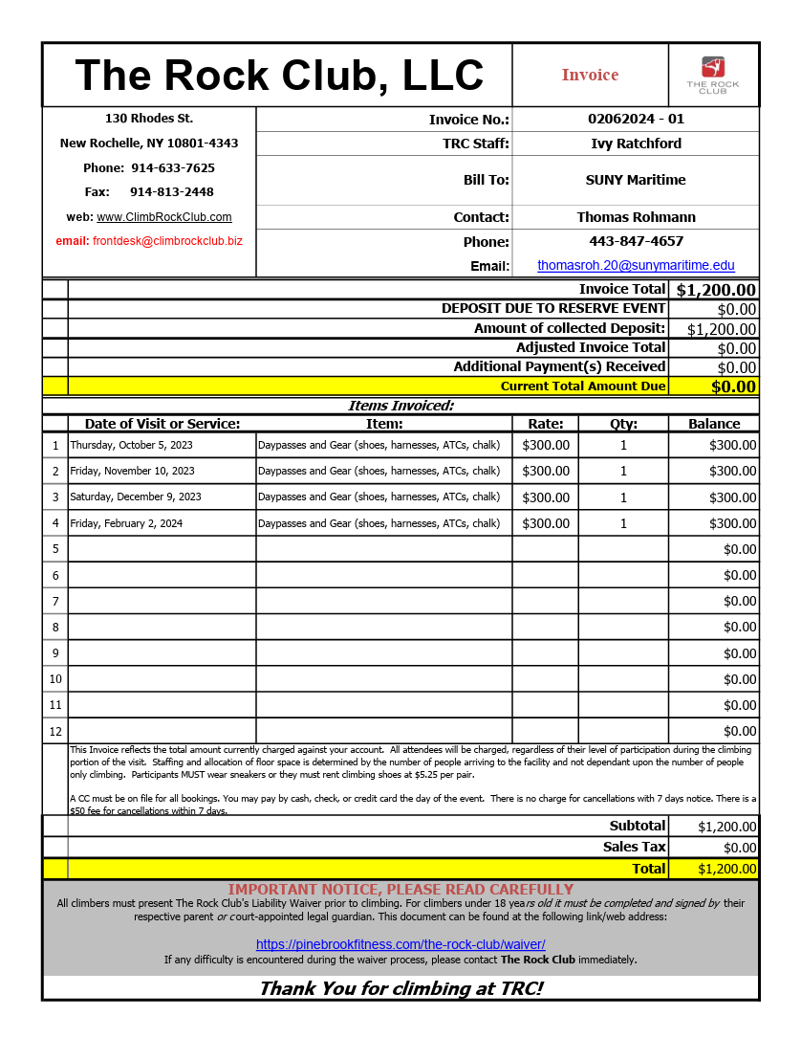
How much does it cost to do this?
$1,200 Spent last semester for gym access

Slide 7
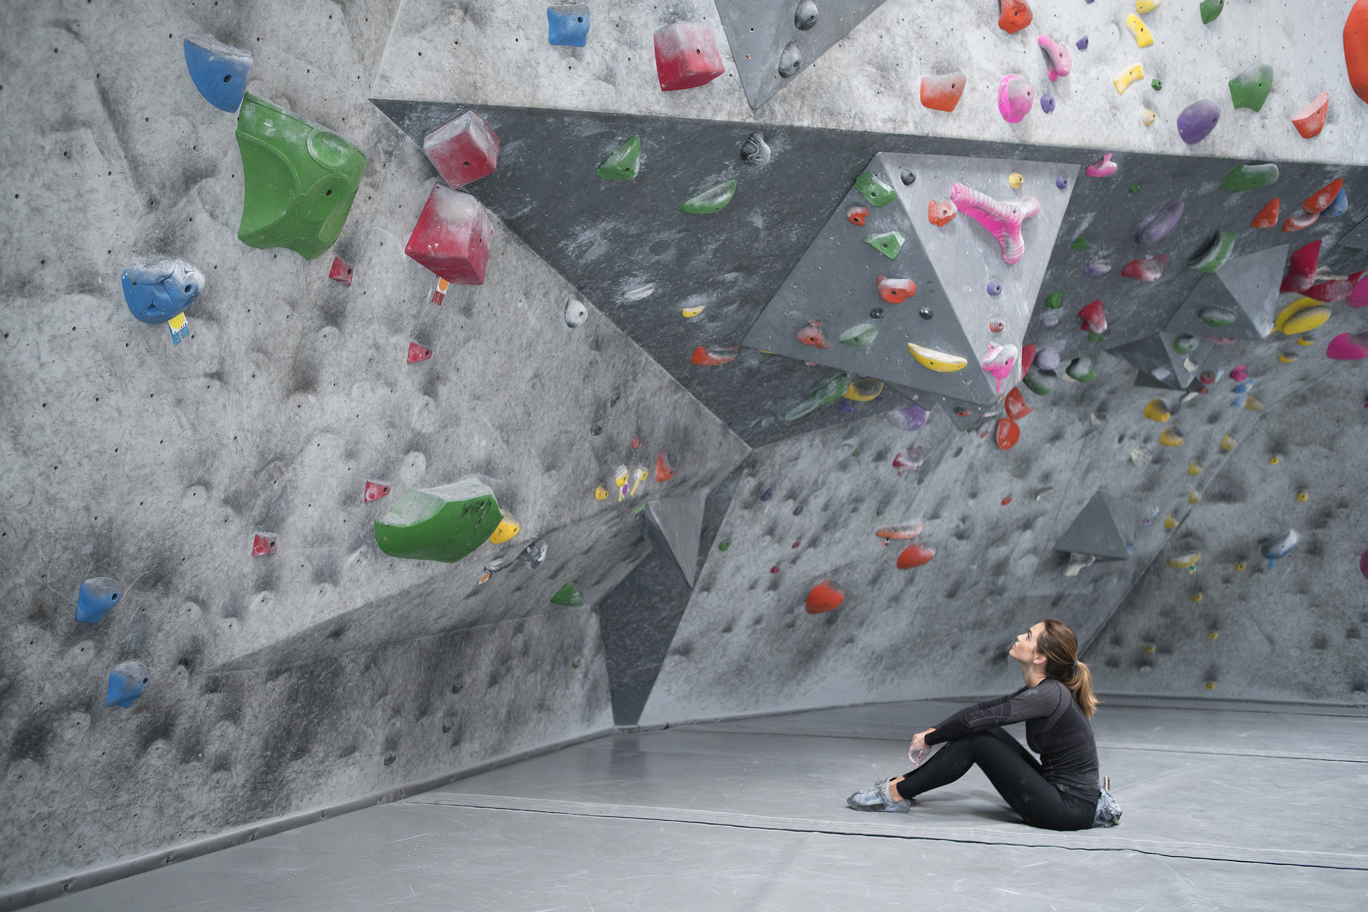
How we raised funds
$500 from Parents Association Last semester
In the process of applying for Parents association funding and FSA Funding for this semester
Internal fundraising ($36 buy in to use club money at climbing gym)
Presenting to SGA, asking $2,500

Slide 8
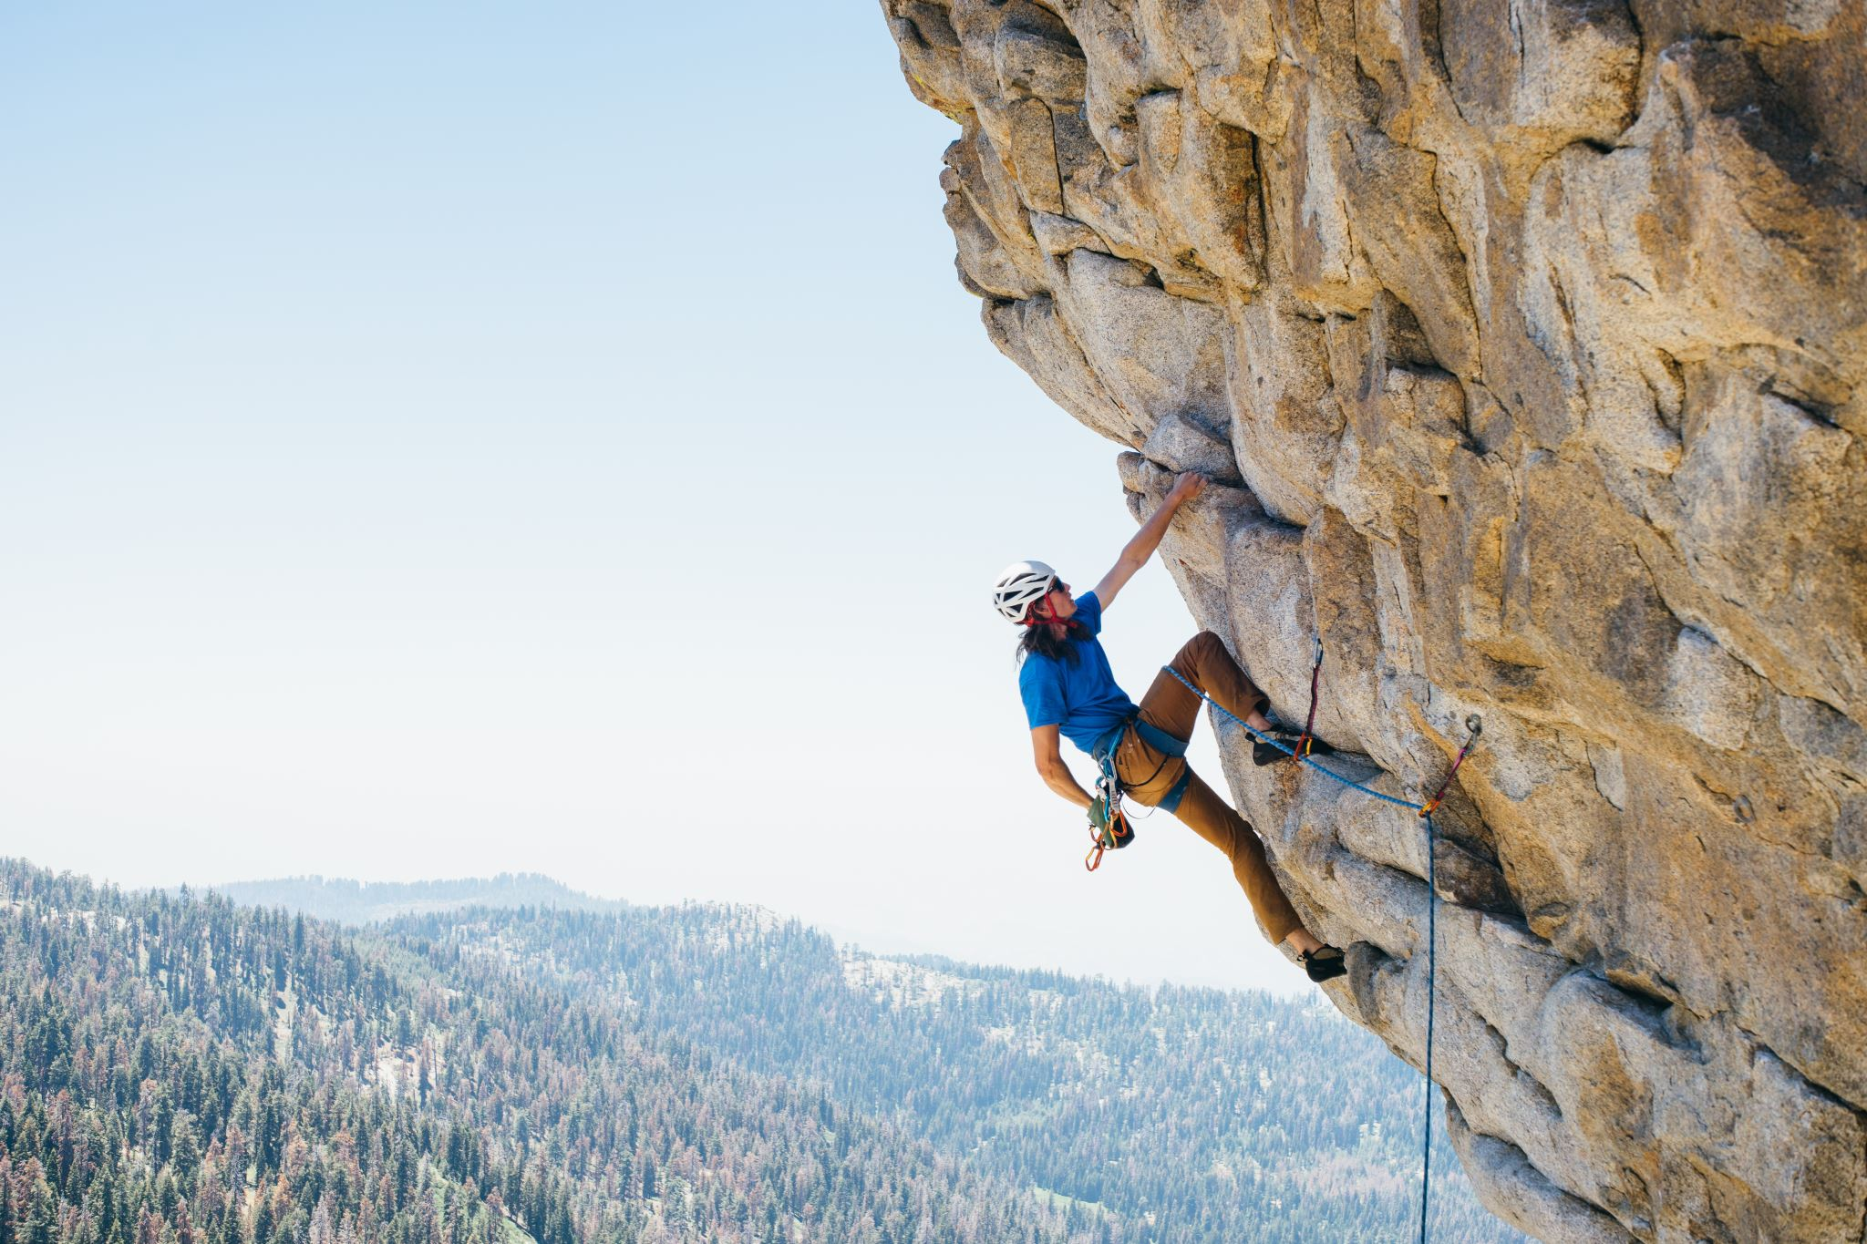
What Our Funding Does
Paying fee to Rock Club
Trips
Shawangunk Ridge Mountains trip
Club Raffle and Events
Equipment Raffle

